Slide 1
CS 2690 Computer Networks II Lecture 23 Chapter 8: Network Security Introduction to Network Security

Slide 2
Network Security Technologies That Use Cryptography
Cryptography (encryption) is the key element in all of these network security technologies:
Privacy or confidentiality technologies prevent the disclosure of information to unauthorized individuals
Authentication technologies verify that the parties involved in network communication are who they claim to be
Data Integrity technologies support authentication by verifying that a message has not been altered during transmission
The parties involved in secure communication are usually called participants, principals or subjects ( in examples, almost universally called “Alice” and “Bob”, with “Eve” as the evil eavesdropper)
(Cryptology is the study of cryptographic theory and systems)

Slide 3
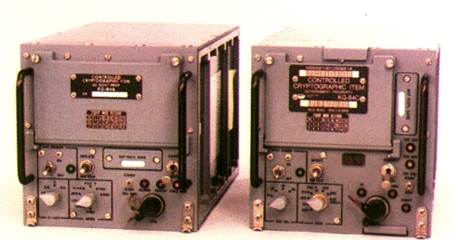
KG-84 “Crypto Gear”
These KG-84A and 84C encryption devices were developed
by the National Security Agency for use by the U.S. military.
128 bit keys were installed with a removable memory device.
From http://en.wikipedia.org/wiki/KG-84

Slide 4
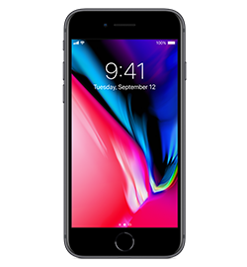
Top-Secret Biometric Device

Slide 5
Where Security Fits in the Protocol Stack
Adapted from SSL and TLS by Eric Rescorla, Addison Wesley

Slide 6
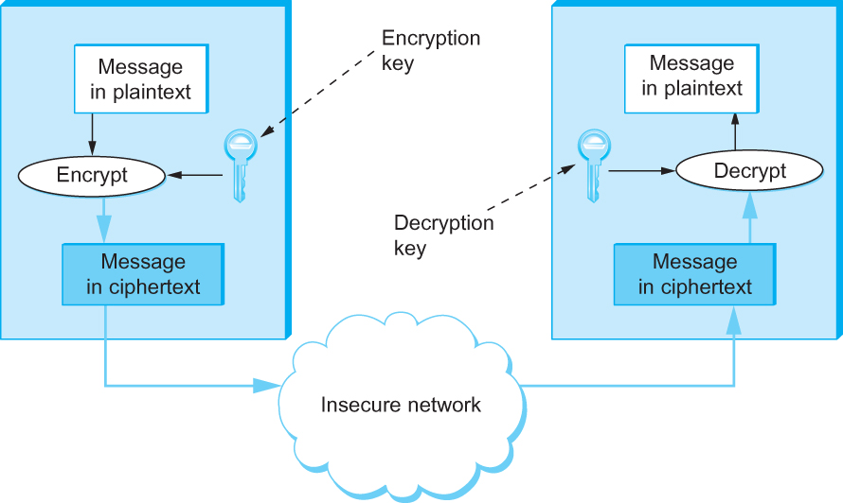
Figure 8.1 Symmetric-Key Encryption and Decryption

Slide 7
Cryptographic Terms
Cleartext or plaintext – message that has not yet been encrypted, or that has already been decrypted (does not necessarily imply text characters, could be anything)
Ciphertext – message that has been encrypted, usually to protect it from disclosure to unauthorized participants (such as Eve)
Cipher – an algorithm or calculation that encrypts or decrypts a message
Key – a binary value, generally the “secret” used to encrypt and decrypt a message
May be based on a “password” or randomly generated
Typically large, hard to guess, random, and protected from disclosure
Not always a secret
Lifetime before expiration may be seconds to years

Slide 8
Factors That Determine Effectiveness of Cryptography
Key length
Longer and more random keys are harder to guess or “brute force”
Some ciphers offer a choice of key lengths
The strength of the cipher (encryption algorithm) – how well it hides the plaintext data
Whether the cipher process is public knowledge
How carefully the key is protected from disclosure
How frequently the key is changed, and how many messages are encrypted with the same key
Whether anything can be assumed about message content (e.g., a certain header format, size of data fields)
How we organize the data after encryption (called the mode of operation)

Slide 9
Taxonomy of Network Security

Slide 10
Figure 8.1 Symmetric-Key Encryption and Decryption
(Both participants
use the same key)

Slide 11
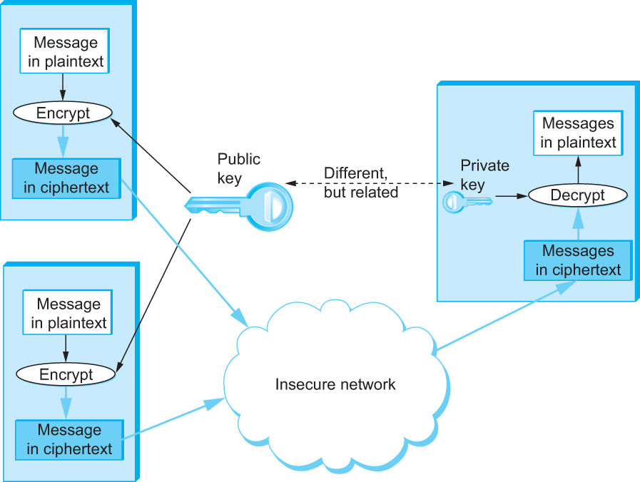
Figure 8.3 Public-Key Encryption
Non-secret shared
(Secret)
Two different
transmitting
participants

Slide 12
Message Digest

Slide 13
High-Level Outline of DES

Slide 14
Players in the World of Cryptographic Security
National Security Agency (NSA)
An agency of the US Dept. of Defense (Ft. Meade MD)
Largest US intelligence agency, and world’s foremost experts in cryptography
Tasked with using cryptography to protect US government and military communications, and with intercepting the communications of other nations (friend and foe)
The Five Eyes Nations
The UK, Australia, New Zealand and Canada have treaties of cooperation in comm intel with the US and NSA
Government Communication Headquarters (GCHQ)
UK equivalent of NSA (they often team up)
National Institute of Standards and Technology (NIST)
US Dept. of Commerce lab that approves most commercial ciphers used worldwide (often uses NSA expertise)
Electronic Frontier Foundation (EFF)
Defender of civil liberties and privacy in the digital realm
Opposes many NSA and FBI policies and operations
American Civil Liberties Union (ACLU)
Foremost defender of civil liberties & US Constitution’s Bill of Rights in US courts, provides legal counsel to EFF and others

Slide 15
Quiz Next Time
Covers text pp. 601 - 622 and 633 – 638, which includes JPEG, MPEG, and introductory security; and lectures 20 – 23.

